Slide 1


COMPARISON BETWEEN MARTI SCOOTERS AND WALKING

Slide 2
Using a scooter instead of walking leads to time savings, but incurs additional costs.
HYPOTHESIS

Slide 3

My data belongs to martı mobile app
*Dates
*Distance
*Time
*Price

Slide 4

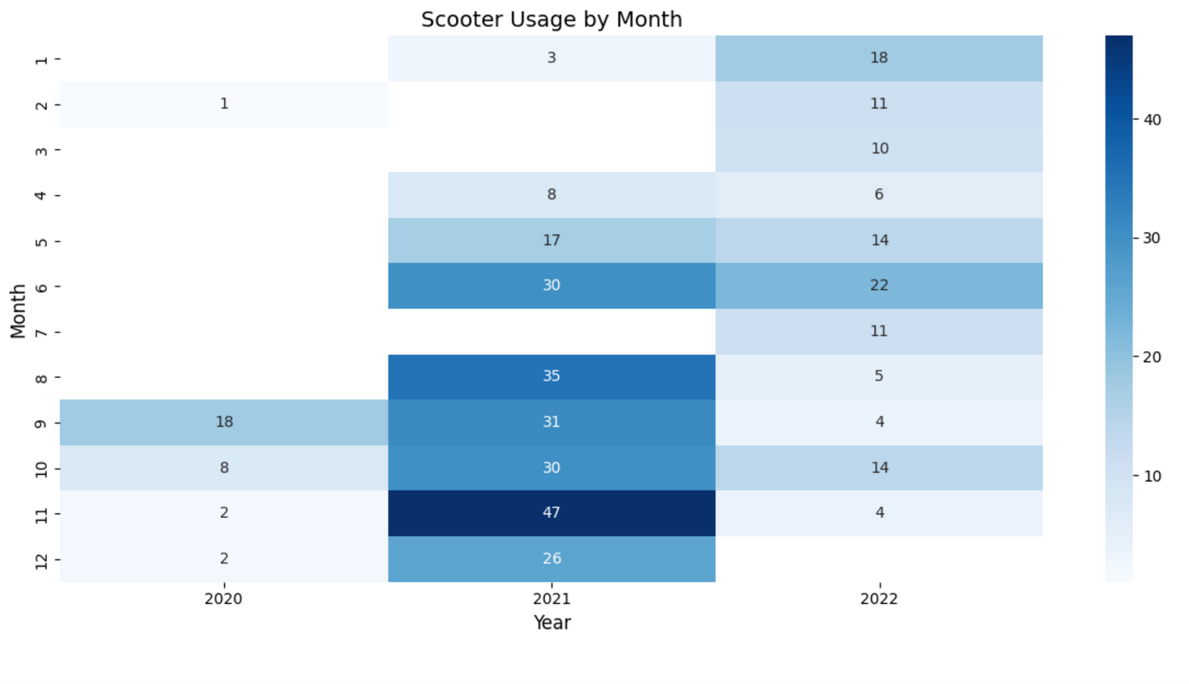
Scooter usage varies significantly across months and years, with the highest activity observed in 2020, 2021 and 2022

Slide 5
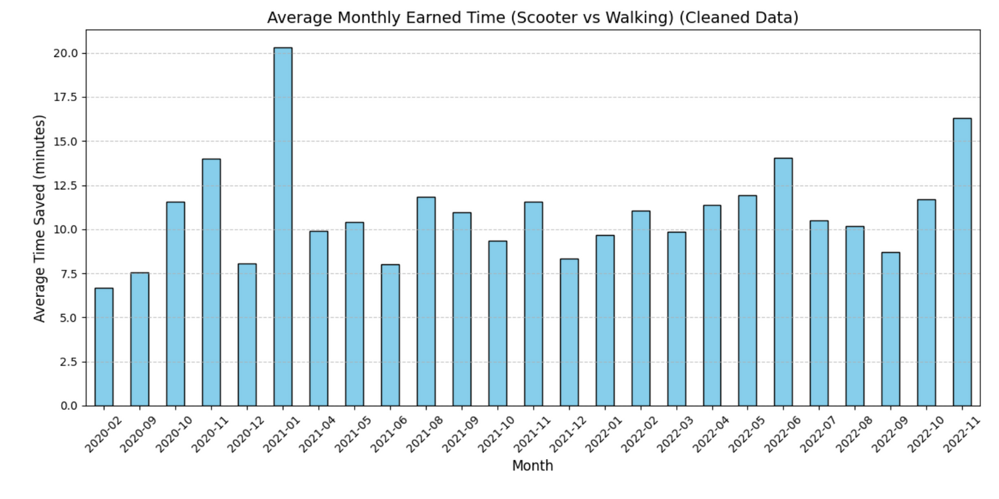
The graph shows the average monthly time saved by using scooters instead of walking, with noticeable peaks text

Slide 6
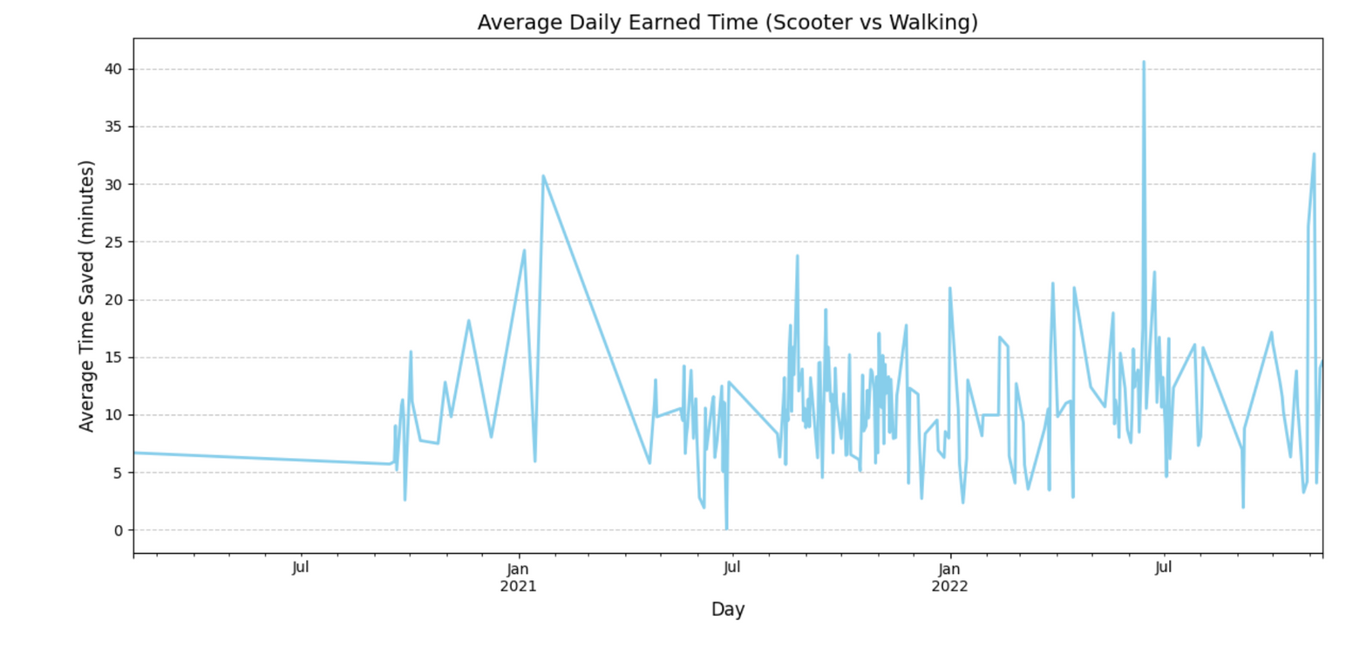
The graph illustrates the fluctuations in average daily time saved by using scooters instead of walking, with notable spikes

Slide 7
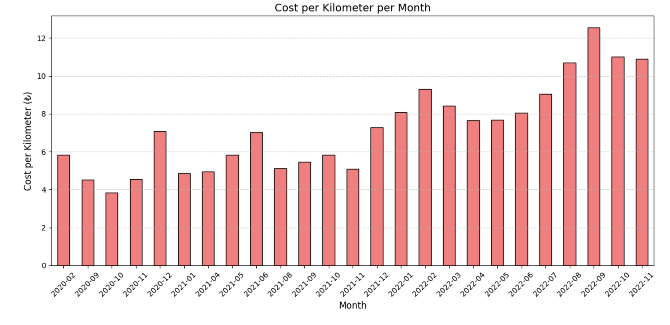
The graph highlights the cost per kilometer for scooter usage across months, showing a gradual increase over time with a peak

Slide 8
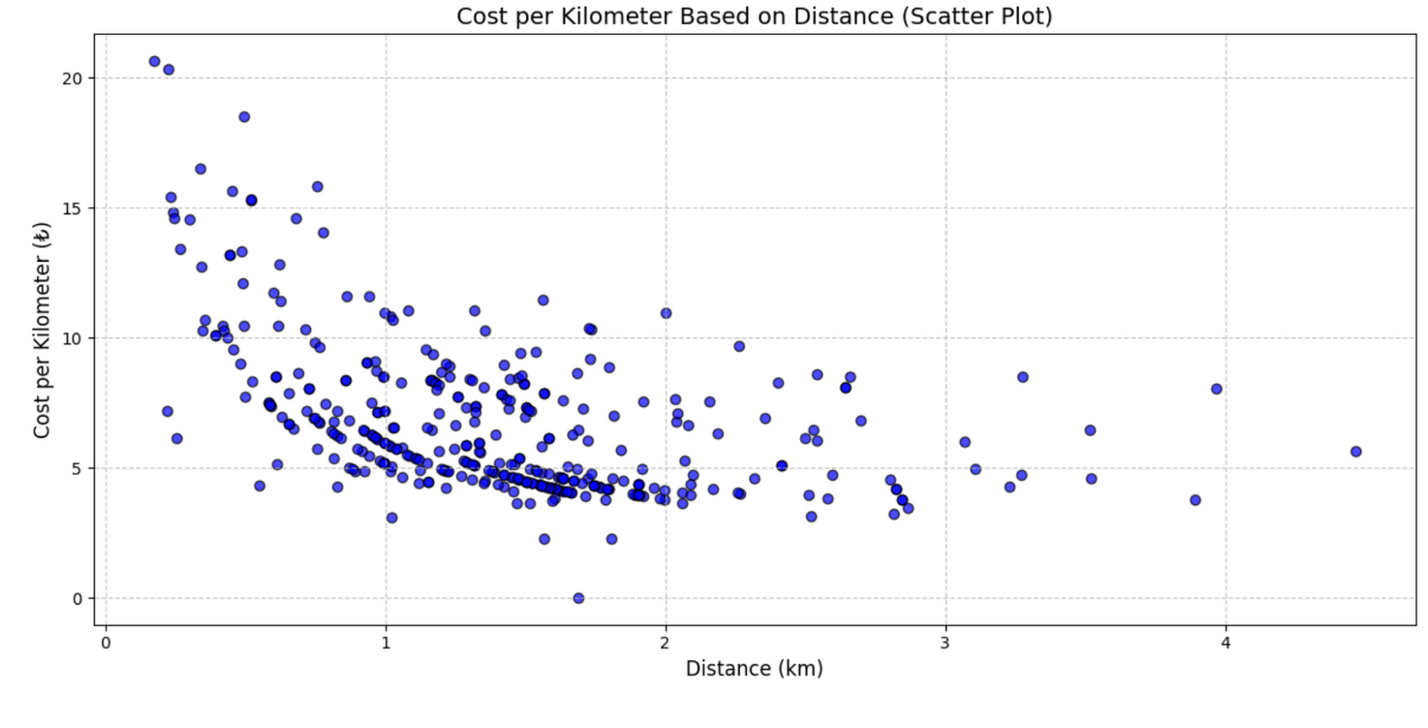
The scatter plot demonstrates that the cost per kilometer decreases as the distance increases, indicating a more economical rate for longer trips.

Slide 9
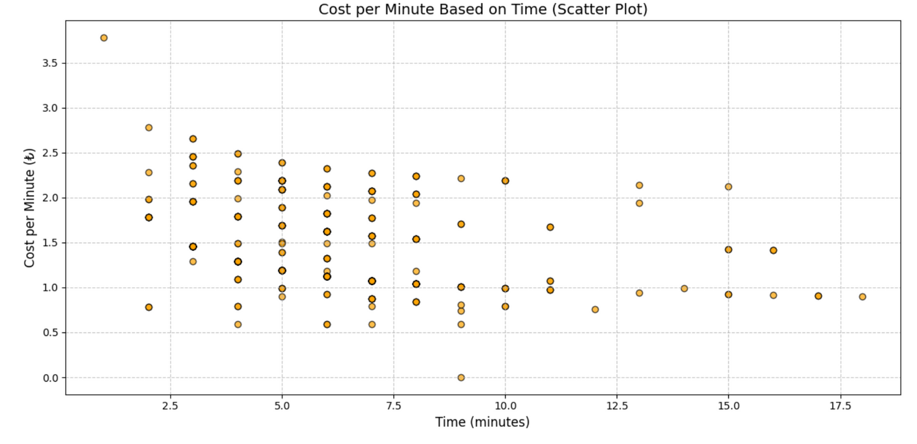
The scatter plot shows that the cost per minute stabilizes as the trip duration increases, with shorter trips generally having higher costs per minute.

Slide 10
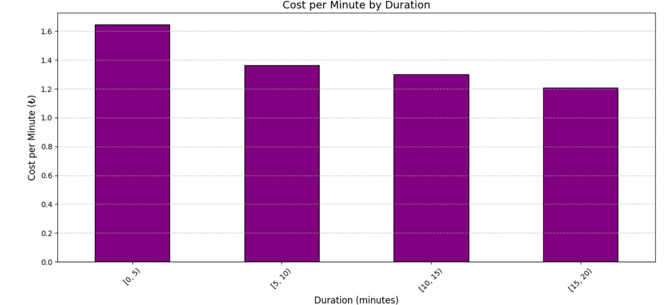
The bar chart illustrates that the cost per minute is highest for shorter durations. (0-5 minutes) and decreases for longer trips, reflecting economies of scale in scooter usage.

Slide 11
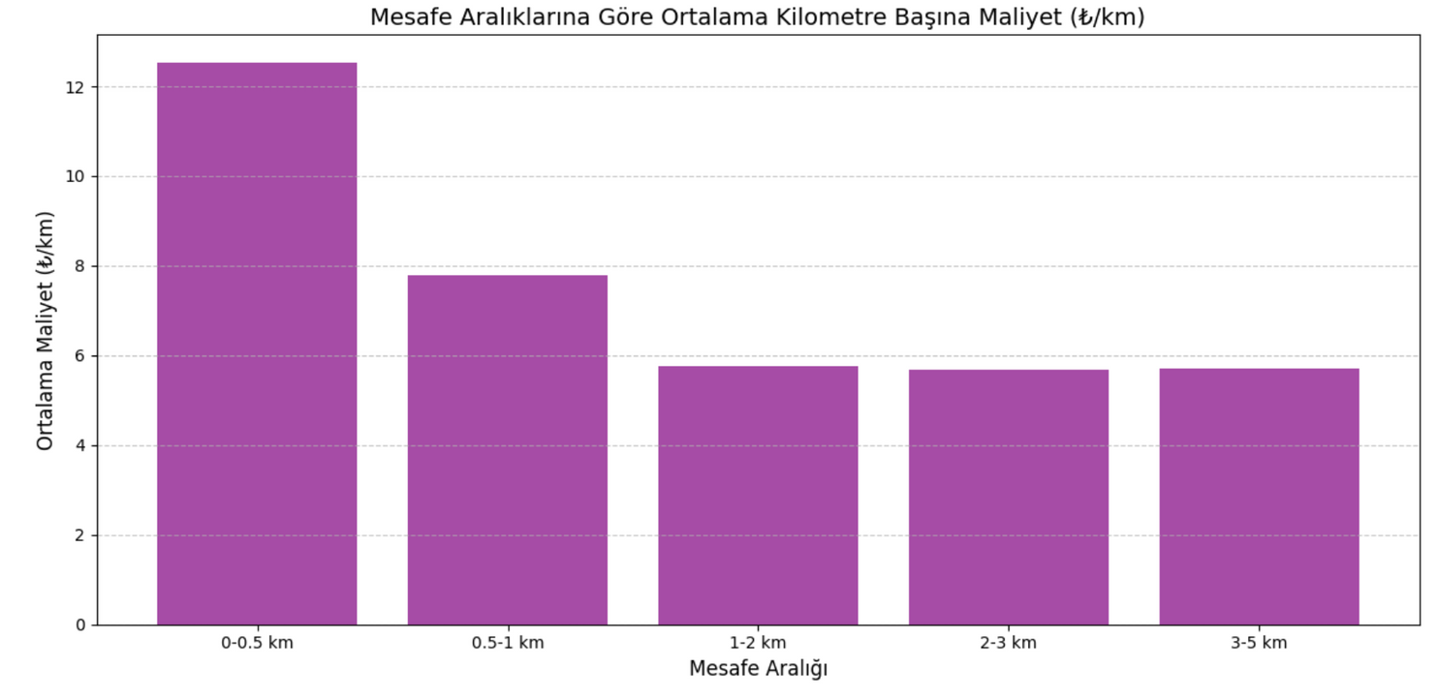
The bar chart shows that the average cost per kilometer decreases as the distance increases, with the highest cost observed in the shortest range (0-0.5 km).

Slide 12
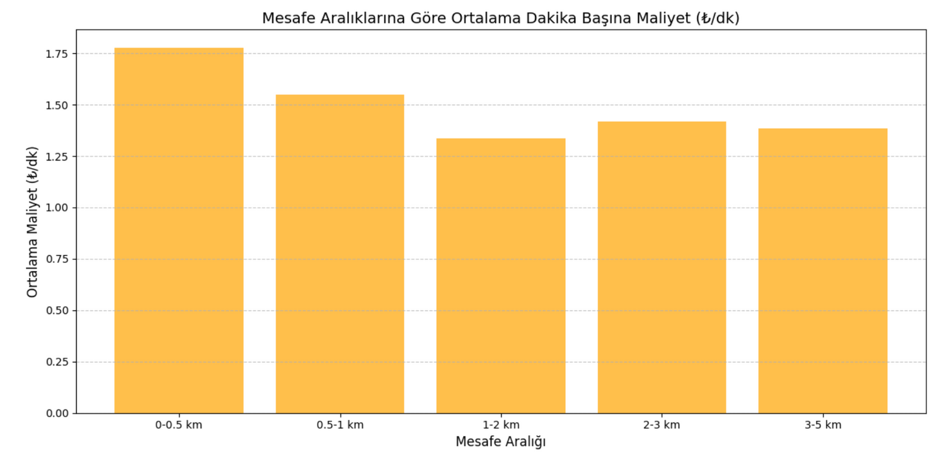
The bar chart demonstrates that the average cost per minute is highest for shorter distances (0-0.5 km) and gradually decreases for longer distance ranges, reflecting a cost efficiency trend.

Slide 13
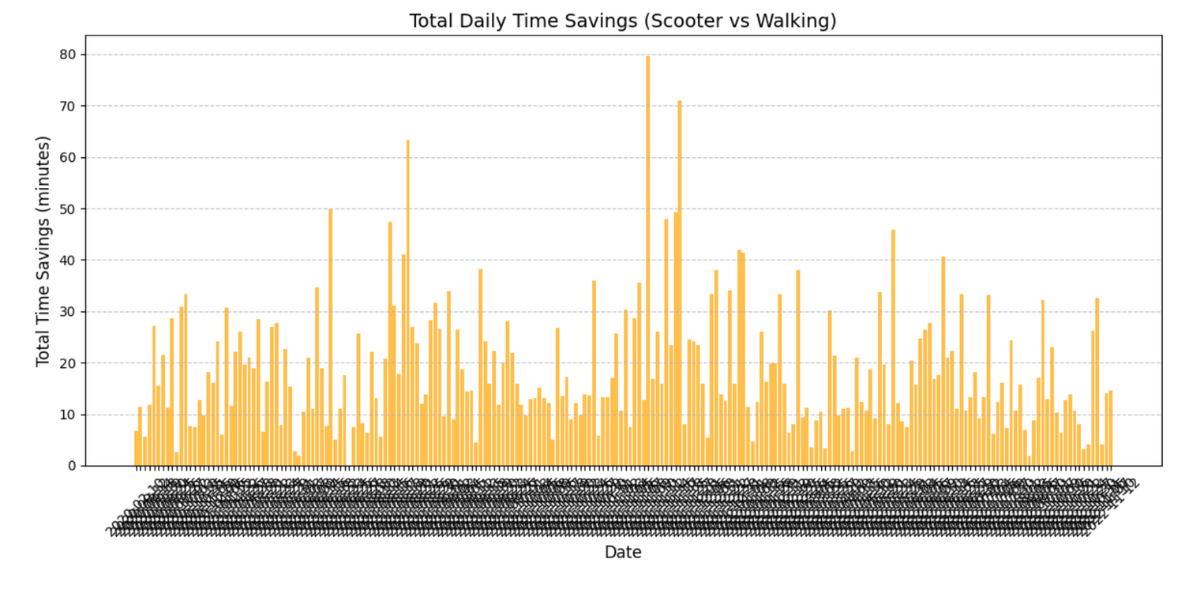
The bar chart displays the total daily time savings achieved by using scooters instead of walking, highlighting significant variations across different days.

Slide 14
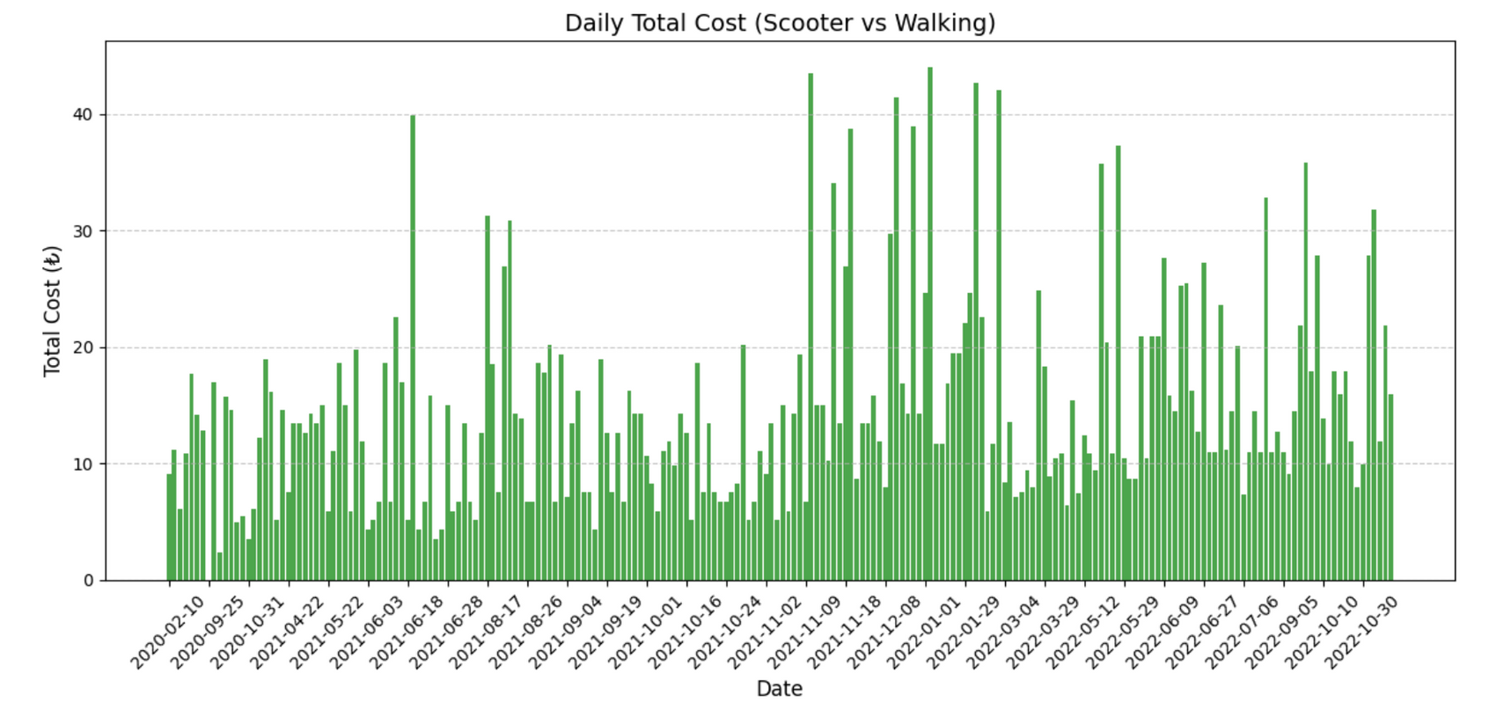
The bar chart represents the daily total cost of using scooters, showing fluctuations over time with occasional peaks indicating higher usage or increased rates.

Slide 15
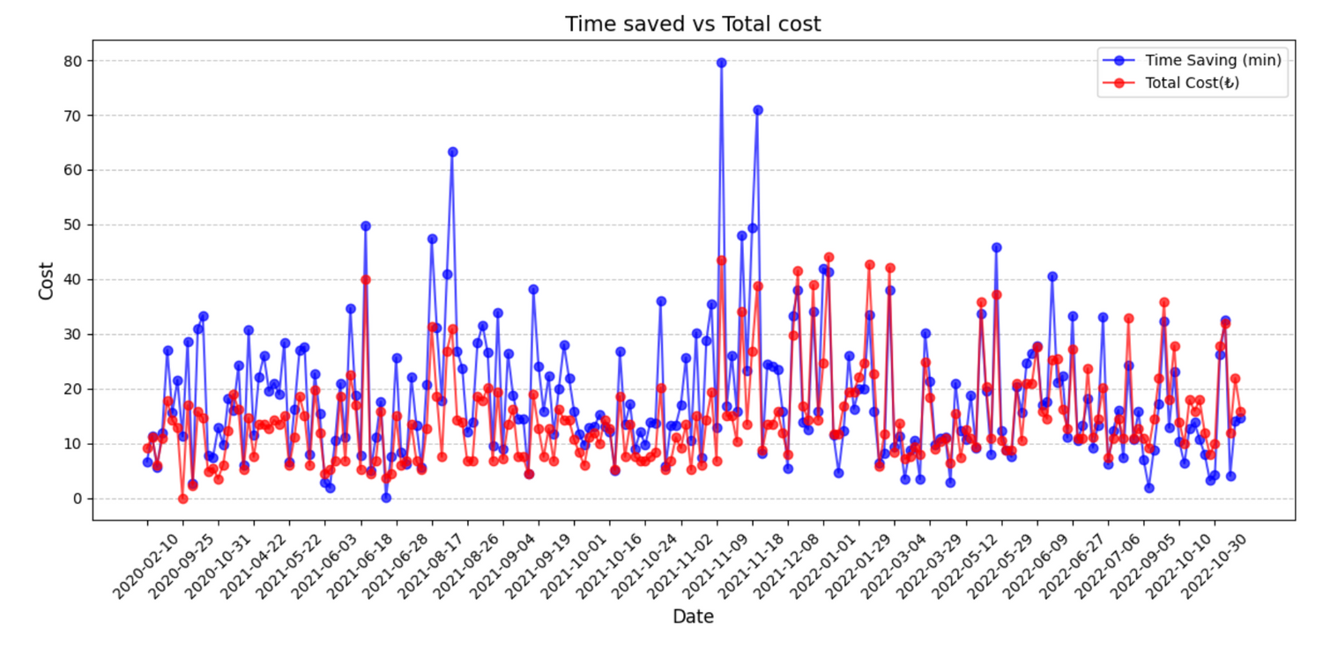
The line chart compares time saved (blue) and total cost (red) for using scooters, revealing periods where higher costs correlate with increased time savings.

Slide 16
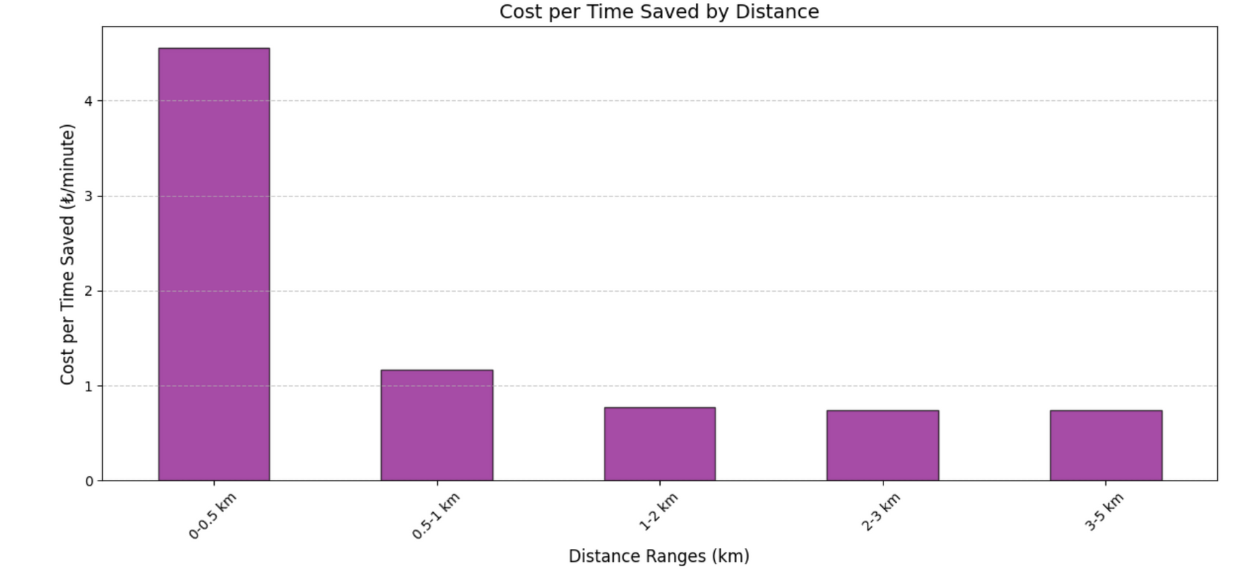
The bar chart highlights that the cost per minute of time saved is significantly higher for shorter distances (0-0.5 km) and decreases as the distance increases, demonstrating cost efficiency for longer trips.

Slide 17
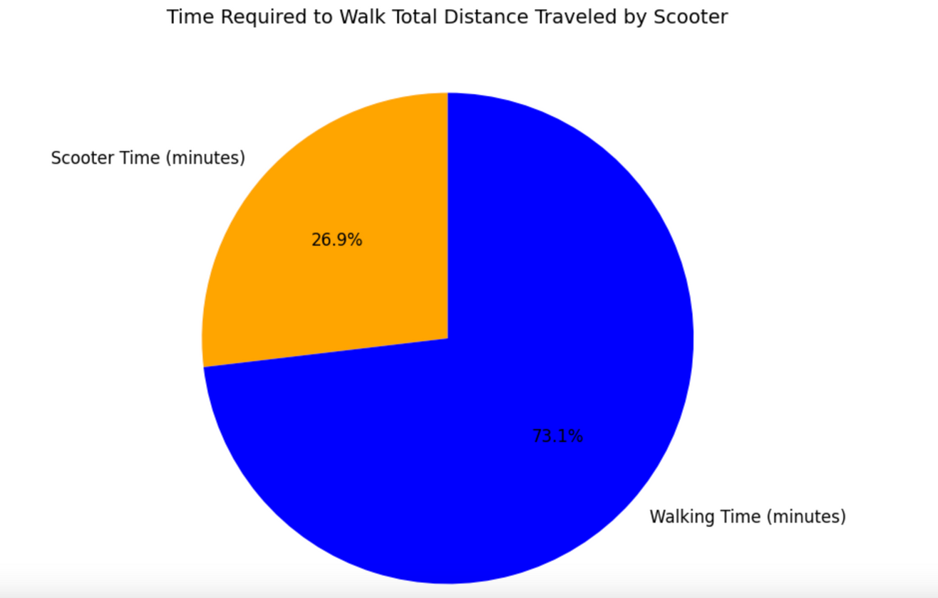
The pie chart compares the time required to walk the total distance traveled by scooter, showing that walking takes significantly more time (73.1%) compared to using a scooter (26.9%).

Slide 18
THANK YOU FOR YOUR TIME

